Slide 1
Engineering Analysis & Design (Modelling & Simulation) Course Code: CO207 Unit -4:Evaluation of Simulation Output

Slide 2
Contents of Module 4
Random Variable and their properties
Estimation Methods, Goodness of Fit, Confidence Intervals
Variance Reduction Techniques ,Validation of Simulation Models

Slide 3
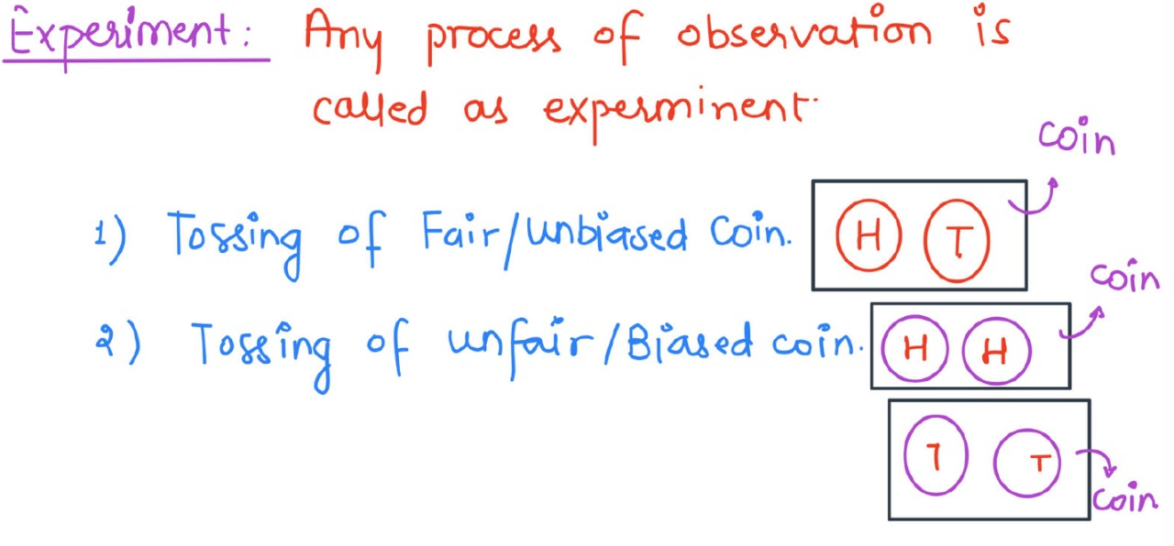
Experiment

Slide 4
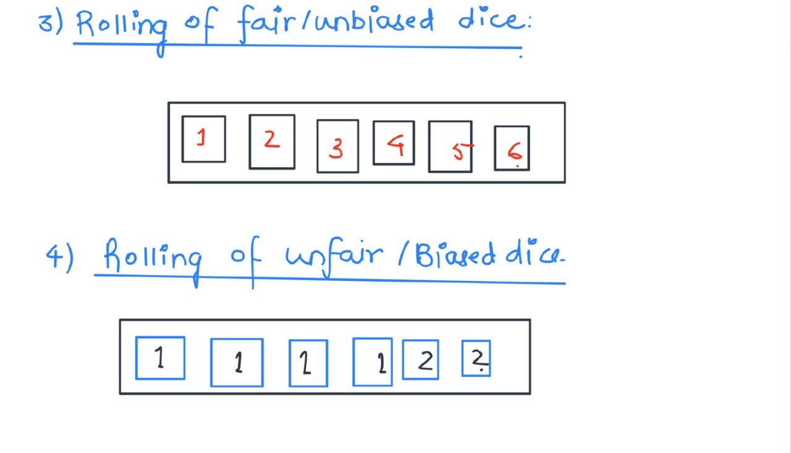
Experiment

Slide 5
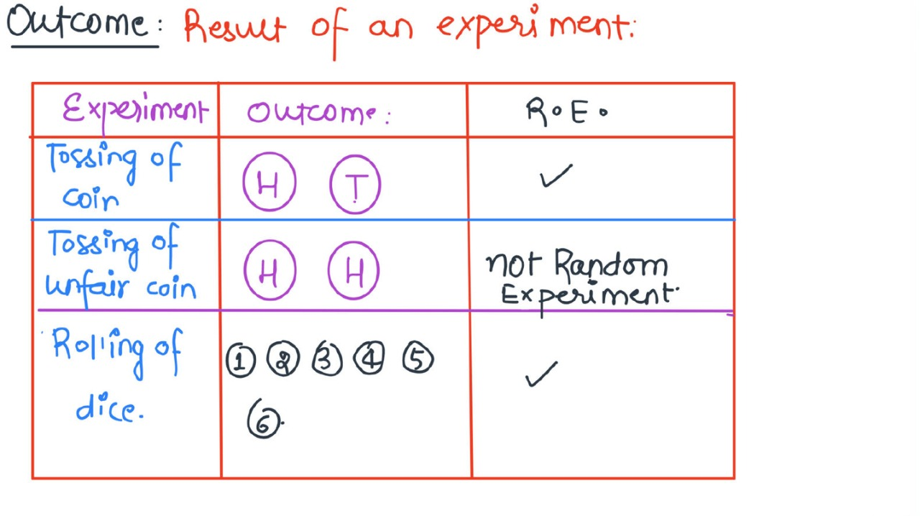
Experiment

Slide 6
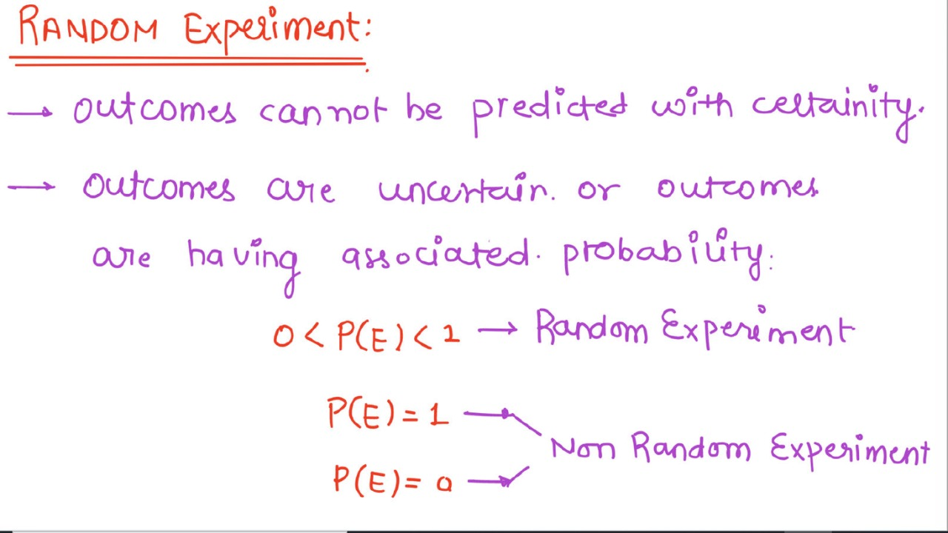
Random Experiment

Slide 7
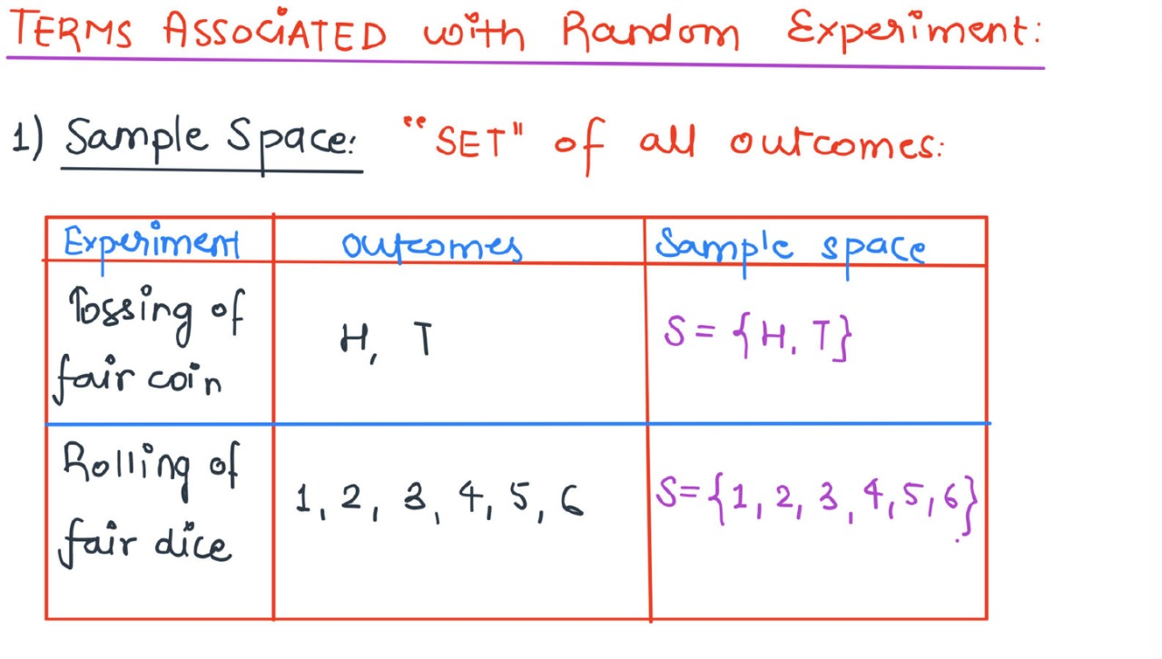
Term Associated with Random Experiment

Slide 8
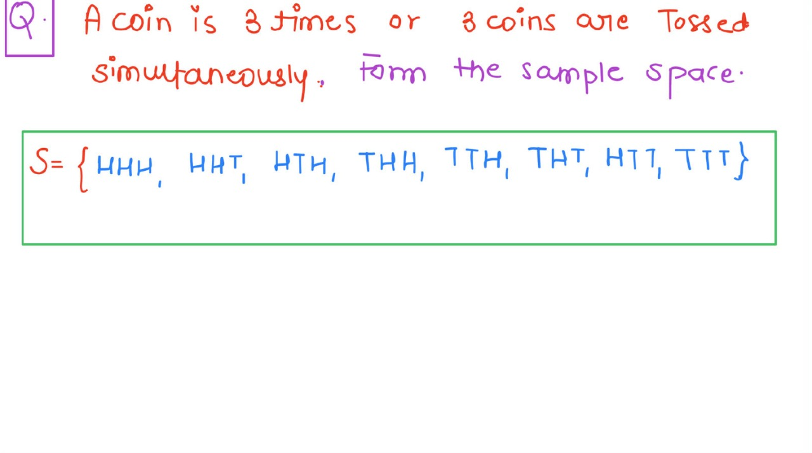
Random Experiment

Slide 9
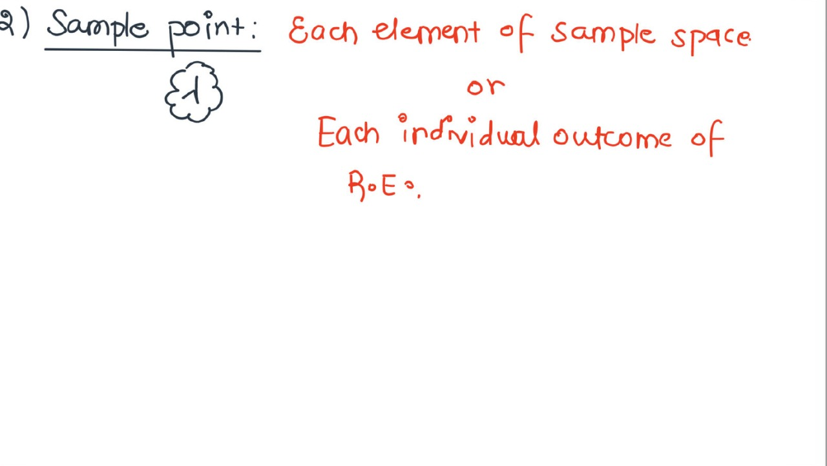
Sample Point

Slide 10
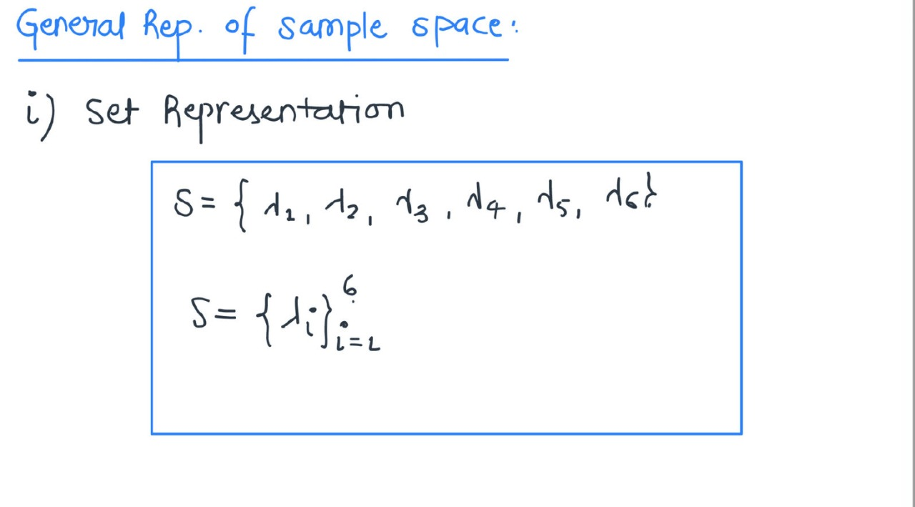
Representation of sample space

Slide 11
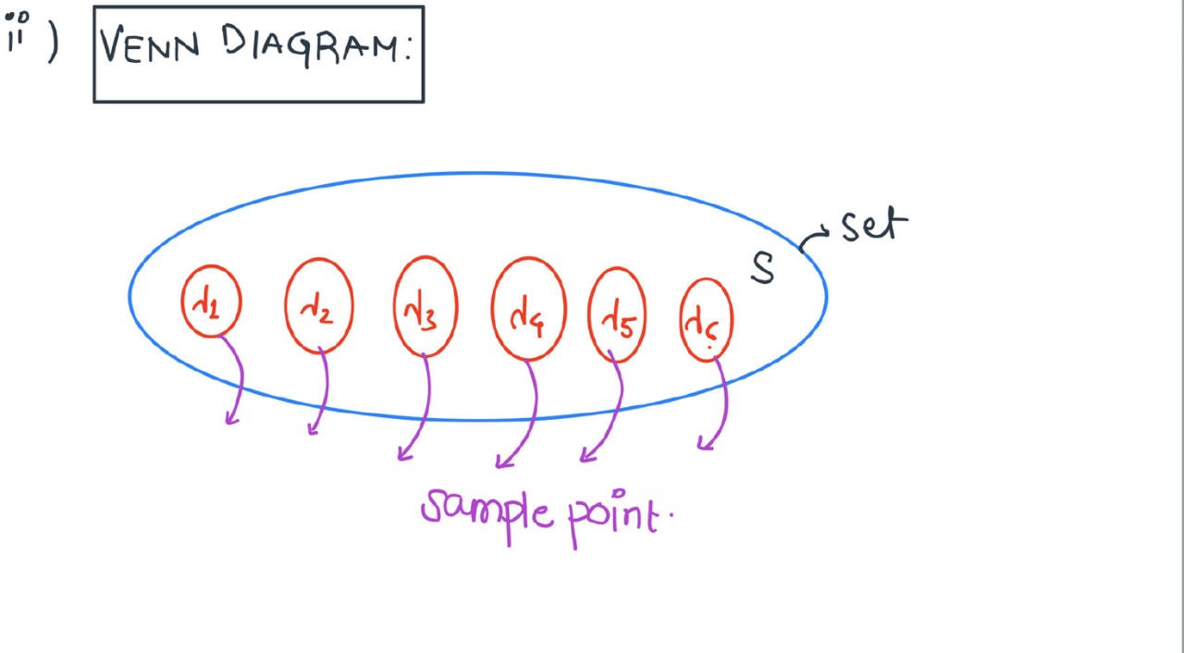
Representation of sample space

Slide 12
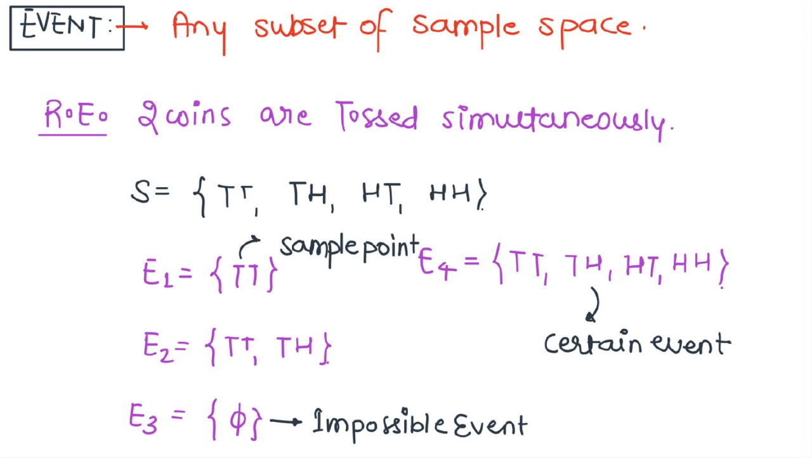
Event

Slide 13
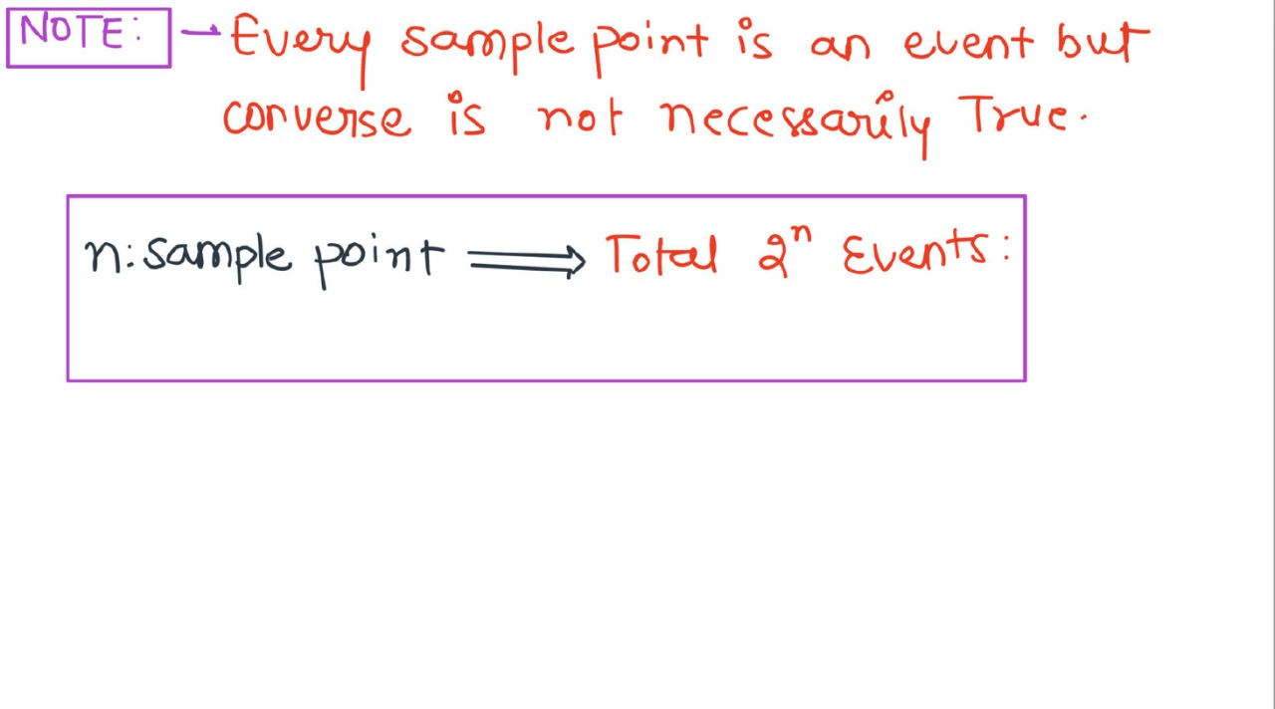
Event

Slide 14
Random Variable
The range of all possible outcomes of an experiment is known as the “Sample Space (S)”.
A Random variable is a function which can take on any value from the sample space and having range of some set of real number is known as random variable
Random variable: Real value of random experiment is called random variable.
A Random variable is a variable that assumes numerical values associated with the random outcome of an experiment, where one (and only one) numerical value is assigned to each sample point.

Slide 15
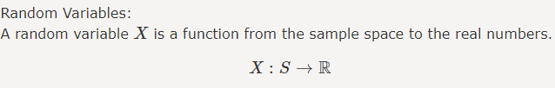

Random Variable Continued….

Slide 16
Example of Random Variable
A typical example of a random variable is the outcome of a coin toss. Consider a probability distribution in which the outcomes of a random event are not equally likely to happen. If random variable, Y, is the number of heads we get from tossing two coins, then Y could be 0, 1, or 2. This means that we could have no heads, one head, or both heads on a two-coin toss.
However, the two coins land in four different ways: TT, HT, TH, and HH. Therefore, the P(Y=0) = 1/4 since we have one chance of getting no heads (i.e., two tails [TT] when the coins are tossed). Similarly, the probability of getting two heads (HH) is also 1/4. Notice that getting one head has a likelihood of occurring twice: in HT and TH. In this case, P (Y=1) = 2/4 = 1/2.

Slide 17
Types of Random Variable
There are three types of random variables:
(1)Discrete random variable
(2) Continuous random variable
(3) Mixed random variable

Slide 18
Discrete Random Variable
A discrete random variable is a variable which can take on only finite number of values in a finite observation interval. So, we can say that discrete random variable has distinct values that can be counted.
Ex.: Number of steps to the top of the Eiffel tower.

Slide 19
Continuous random variable
A continuous random variable that takes can assume any value along a given interval of a number line. Such as length, depth, volume, time, weight and so on.
Many physical systems (experiments) can produce infinite number of outputs in a finite time of observation. In such cases, we use continuous random variables to define outputs of such systems.
Ex.: The time a tourist stays at the top once he/she gets there.

Slide 20
Note:
A random variable that may assume only a finite number or an infinite sequence of values is said to be discrete; one that may assume any value in some interval on the real number line is said to be continuous.
For instance, a random variable representing the number of automobiles sold at a particular dealership on one day would be discrete, while a random variable representing the weight of a person in kilograms (or pounds) would be continuous.

Slide 21
Mixed Random Variable:
A mixed random variable is one for which some of its values are discrete and some are continuous.
The mixed case is usually the least important type of random variable, but it occurs in some problems.

Slide 22
Practice Question
Ques : Given a random variable x has following possible values ,state if X is discrete ,continuous ,or mixed
{-20 < x < -5}
{10,12<x<= 14,15,17}
{-10 for x > 2 and 5 for x<=2 where 1 < x<=6}
{4,3,1,1,-2}

Slide 23
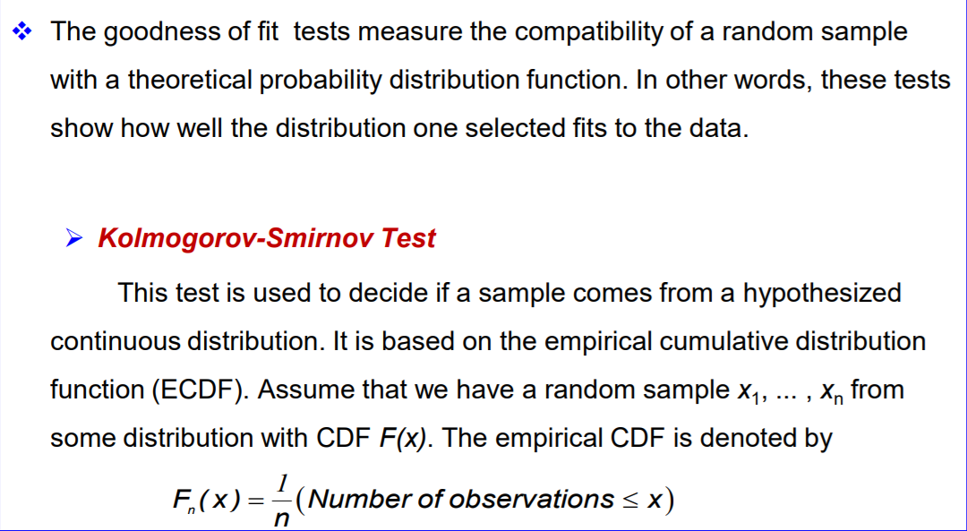
Goodness of Fit

Slide 24
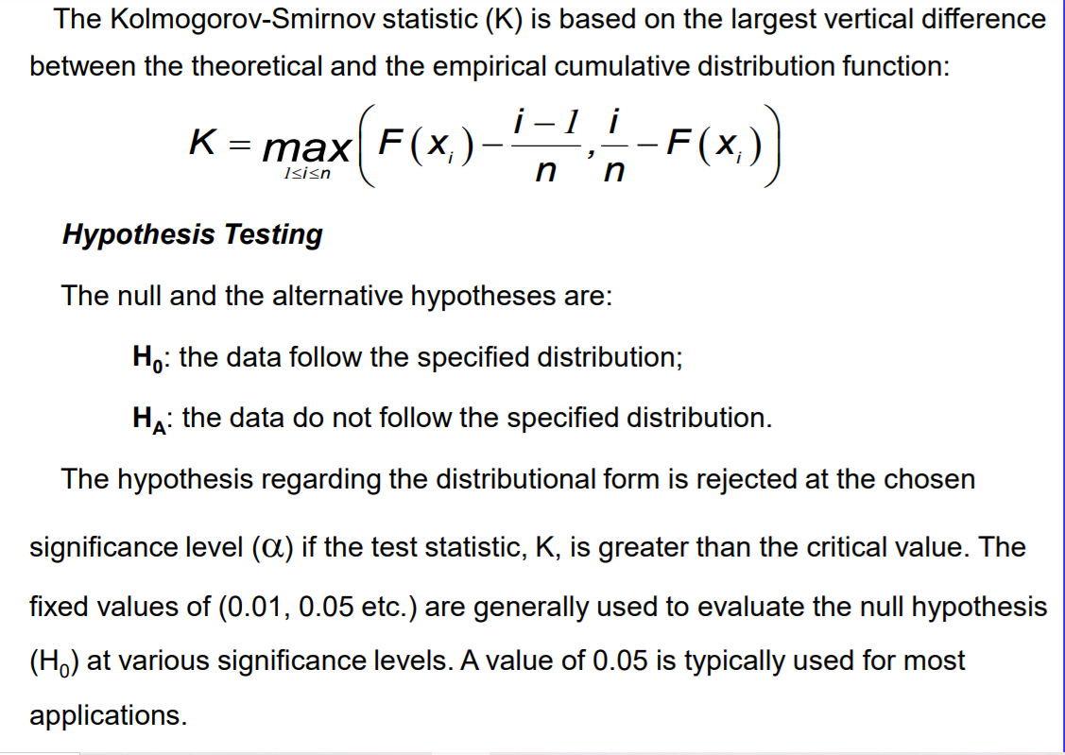
Cont..

Slide 25
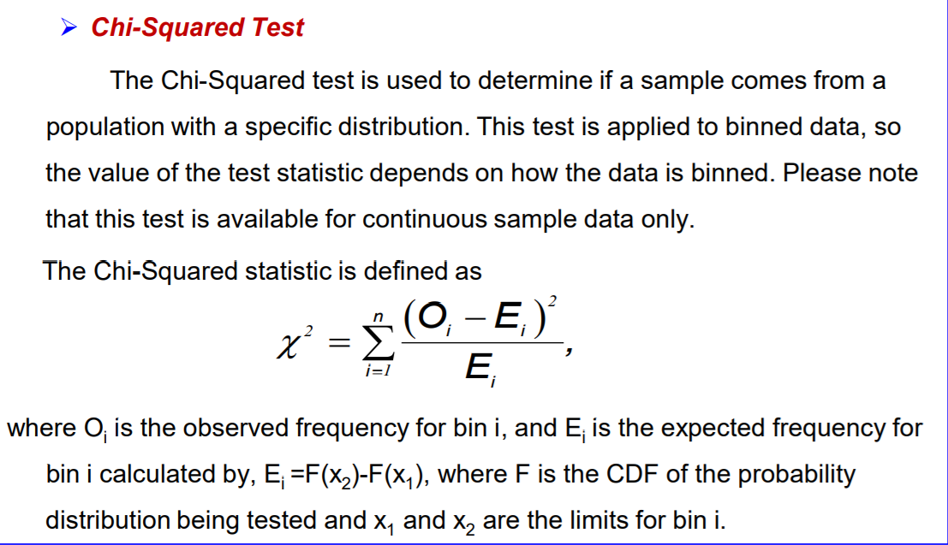
CONT..
Consider a service facility with a single server

Slide 26
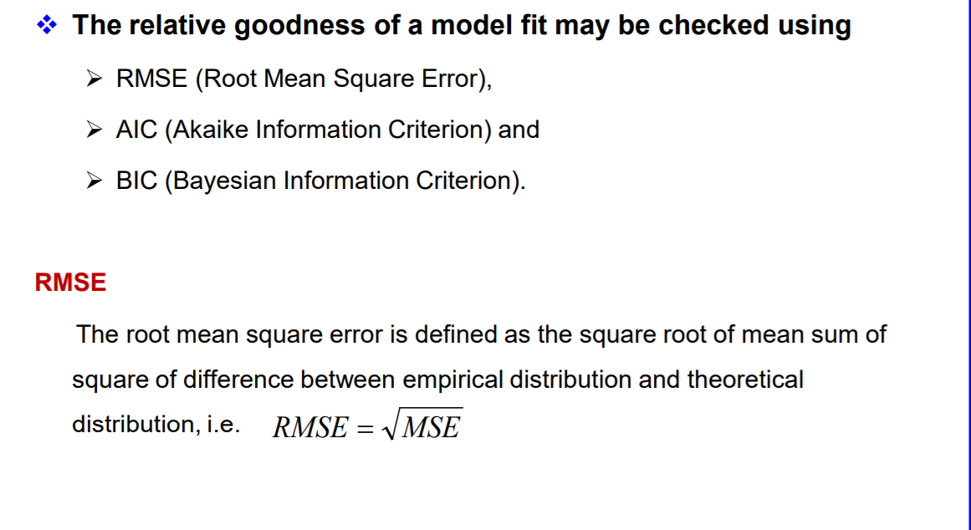
CONT…..

Slide 27
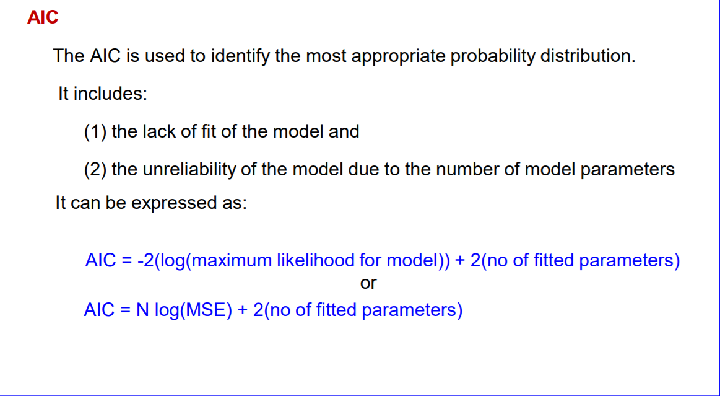
CONT..

Slide 28
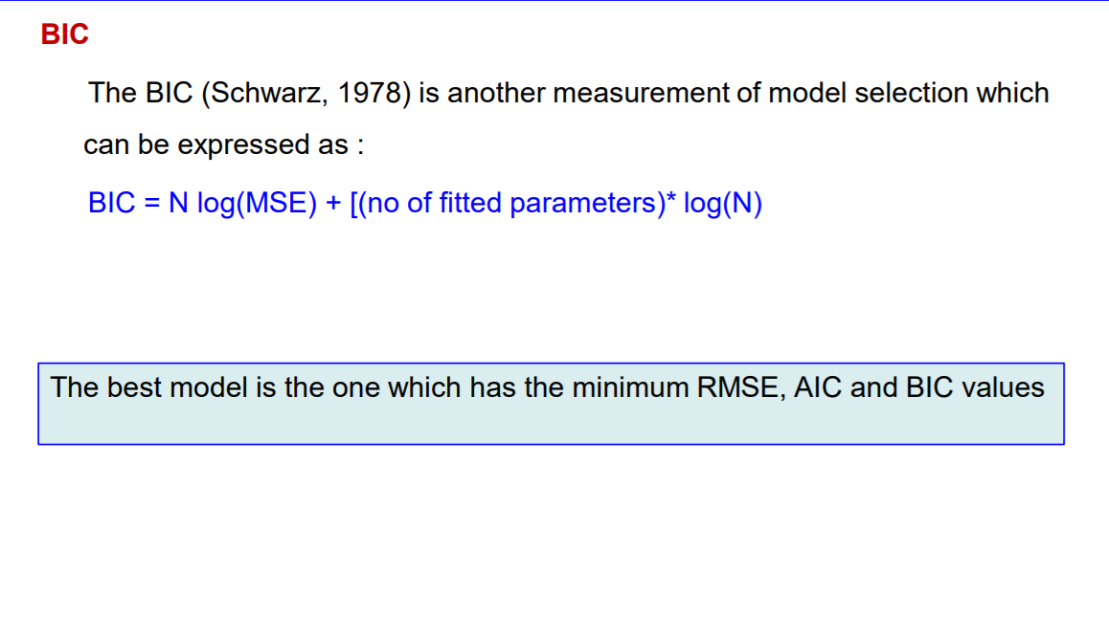
Cont…

Slide 29
Variable: Is a parameter which is changing with outcome for and observed phenomena.
Data :The particular value of the variable is data-value.
Population: The collection of all data is called population.
Sample: A subset of population is called sample.

Slide 30
Examples
e.g. 1; Suppose a dice is thrown 45 times and outcomes are
6,1,6,2,1,6,6,4,1,5,5,5,1,2,6,6,4,2,3,2,4,1,4,4,6,4,3,6,4,3,2,6,4,3,4,3,3,5,4,6,3,3,3,6,5. ..(A)
It can be arranged as (A1)
𝑥 = 𝑛𝑢𝑚𝑏𝑒𝑟 | 1 | 2 | 3 | 4 | 5 | 6
frequency | 5 | 5 | 9 | 10 | 5 | 11
Cumulative freq. (≤) | 5 | 10 | 19 | 29 | 34 | 45
Cumulative freq. (≥) | 45 | 40 | 35 | 26 | 16 | 11
(A) Scattered data , & (A1) grouped data yielding the table called frequency distribution

Slide 31
Examples
e.g, 2; Consider the temperature of a city we have
71.1, 71.4, 71.9, 72.8, 75.9, 76.6, 76.9, 78.6, 80.7, 81.6, 81.8, 83.0, 84.0, 86.2,
87.8, 87.9, 88.8, 88.9, 89.4, 91.9, 92.3, 94.1, 94.4, 94.4, 94.6, 94.7, 95.0, 96.0, 96.8,
99.2, 101.0, 101.7, 103.0, 106.0, 107.5 (B)
It can be represented in form of class say
70-75, 75-80, 80-85, 85-90, 90-95, 95-100, 100-105, 105-110.
The mid value of an interval is taken as class value.
Any data falling on class boundaries to be assigned to higher class Data can be represented as
Class bound | 70-75 | 75-80 | 80-85 | 85-90 | 90-95 | 95-100 | 100- 105 | 105- 110
Class value | 72.5 | 77.5 | 82.5 | 87.5 | 92.5 | 97.5 | 102.5 | 107.5
frequency | 4 | 4 | 5 | 6 | 7 | 4 | 3 | 2
Cumulative freq. | 4 | 8 | 13 | 19 | 26 | 30 | 33 | 35
Joining midpoint of the tips of the rectangle in the histogram. The polygon is closed on left and right by joining 67.5 112.5 and in this case sum of the area of rectangle equals to area bounded by frequency polygon and 𝑥 − 𝑎𝑥𝑖𝑠

Slide 32
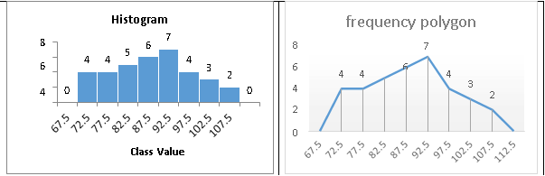

Slide 33
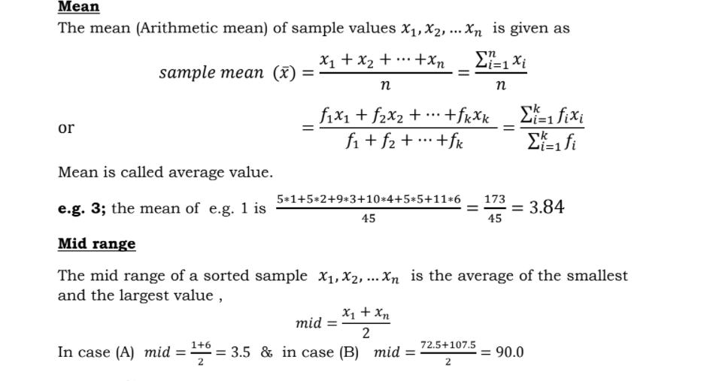
Mean and Mid range

Slide 34
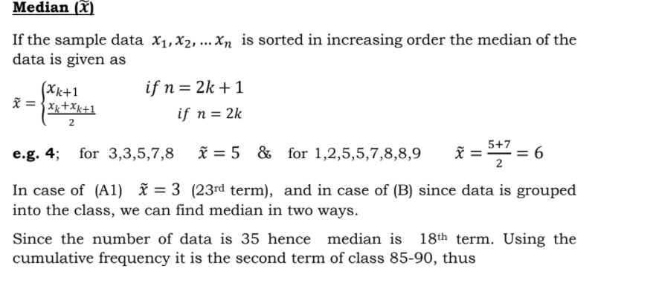
Median

Slide 35
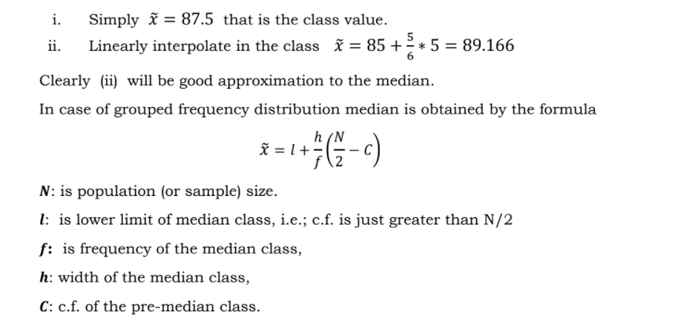
CONT…

Slide 36
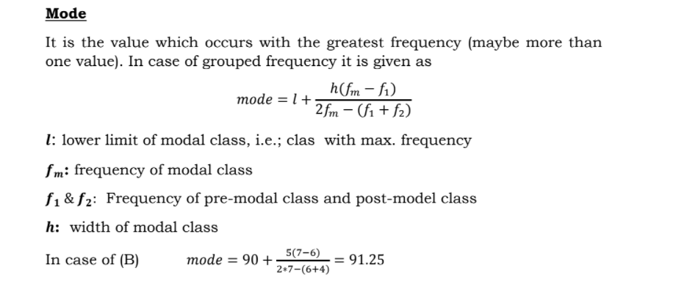
Mode

Slide 37
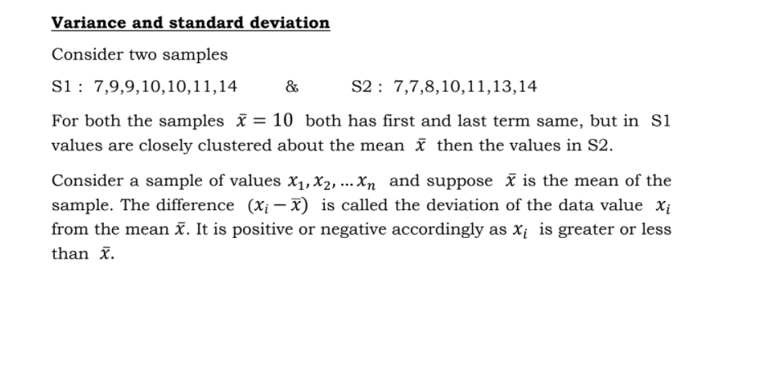
Variance and Standard deviation

Slide 38
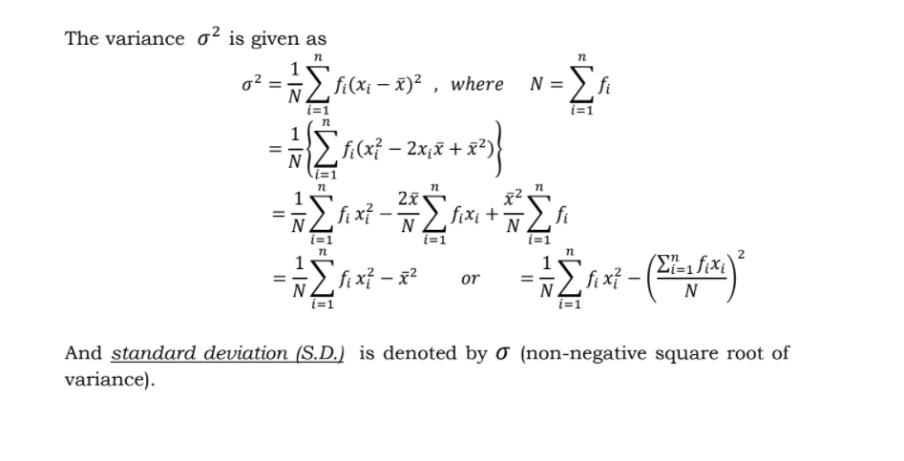
CONT..

